Slide 1
Agenda
Introduction about Cryptography Application of cryptography
Cryptography background Random number generator (PSRNG – Pseudo Random Number Generator, TRNG – True Random Number Generator, /dev/urandom, /dev/urandom) Hash function (MD5, SHA1, SHA256, SHA512,…) Symmetric Key Cryptosystem (DES, AES,…) Asymmetric Key Cryptosystem (RSA, DSA, ECC, …) Private key, Public key, Certificate, PKI (Public Key Infrastructure), Secure Protocol: SSL(Secure Socket Layer), TLS (Transport Layer Security), SSH (Secure Shell), SFTP (Secure File Transfer Protocol), SCP (Secure Copy Protocol), OTP (One Time Password),…
Framework: OpenSSL, WolfSSL (for embedded system)

Slide 2

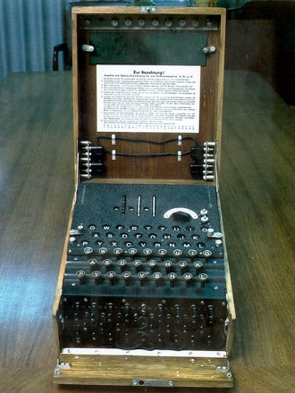
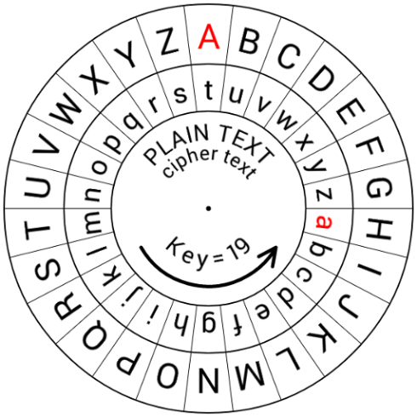
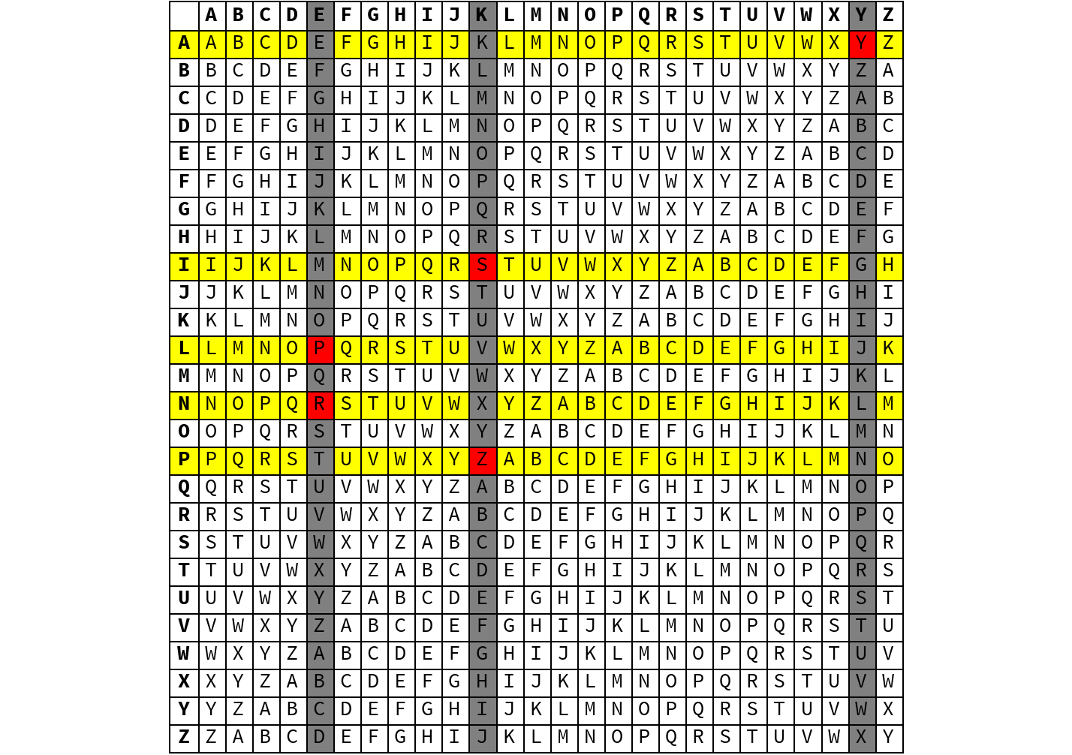
Introduction about Cryptography
Cryptography is the science of using mathematics to encrypt and decrypt data. Began thousands of years ago. More improve until today, with the support of mathematics and computer.

Slide 3
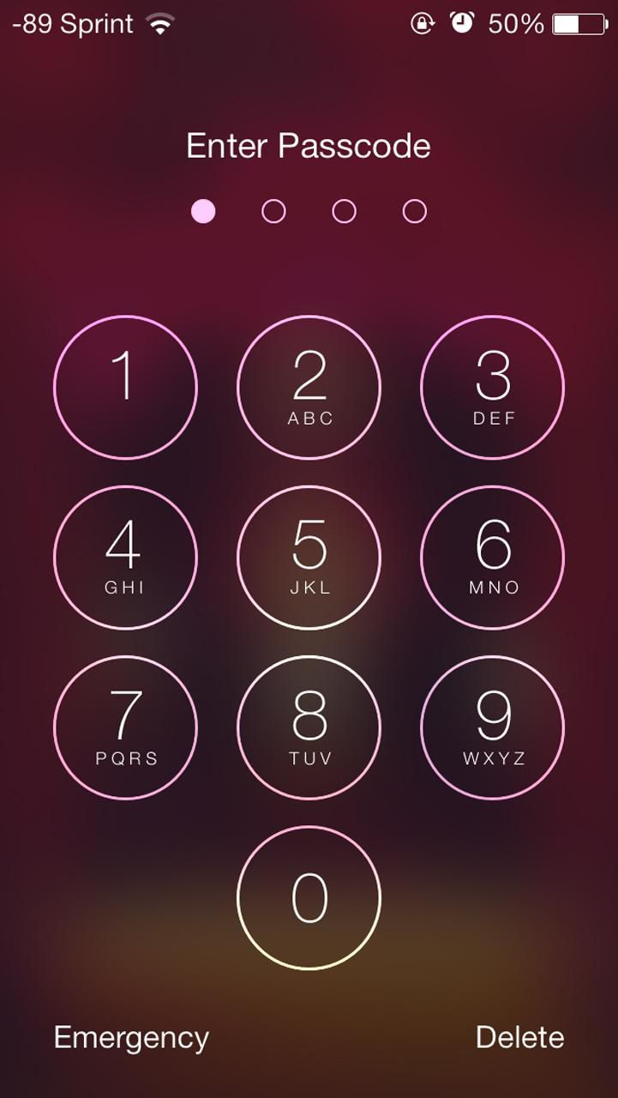
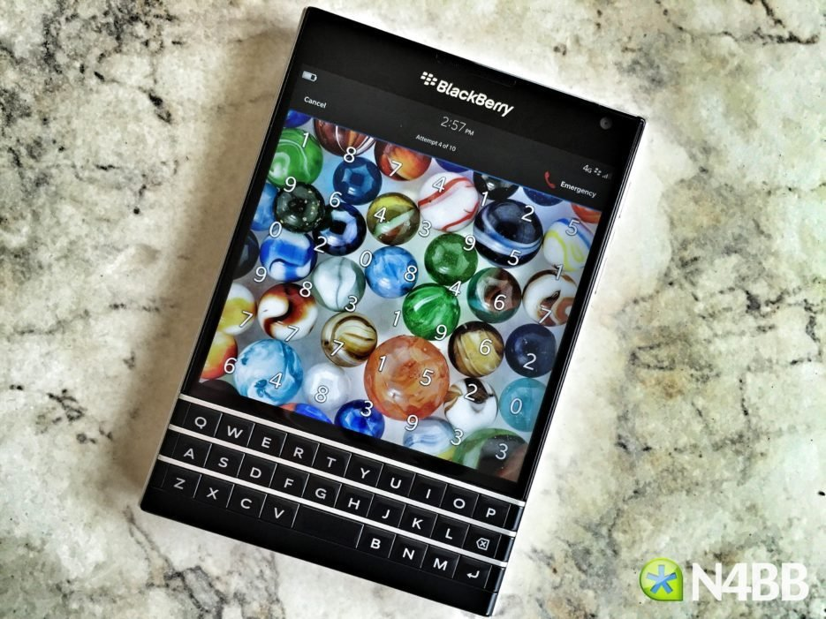
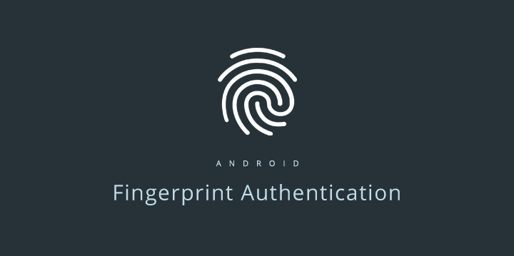
Application of cryptography
Applications: Protect information when store/transmission it: password, identifier number, bank transaction, personal information, sensitive data,… Almost today can’t find an informative system don’t use any cryptosystem.

Slide 4
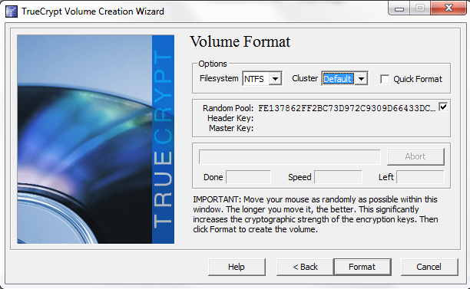

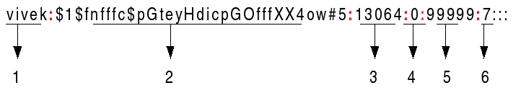
Random number generator
A random data + a predict data => the total data become unpredictable.
PSRNG – Pseudo Random Number Generator: /dev/urandom, srand(time(0)),
TRNG – True Random Number Generator: /dev/random, Always try add amount at least 128 bytes random data with the real data you need protect.

Slide 5
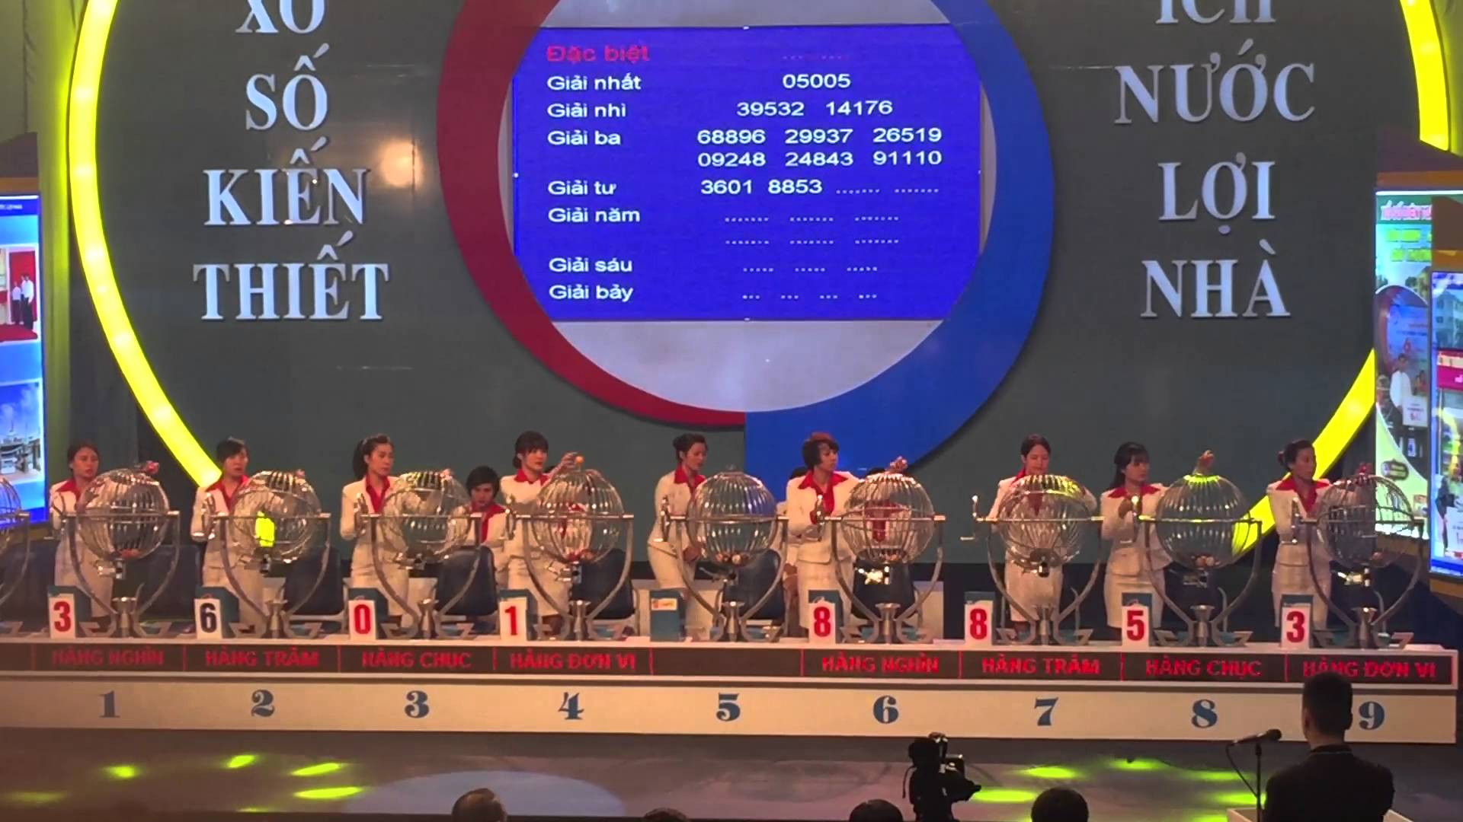
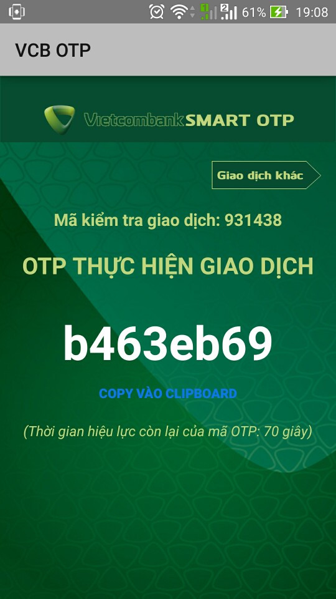
OTP (One Time Password)
It is the best strong secure method until today. Despite the OTP have only two digit number, it’s still very hard for guess correct it by only ONE time.

Slide 6
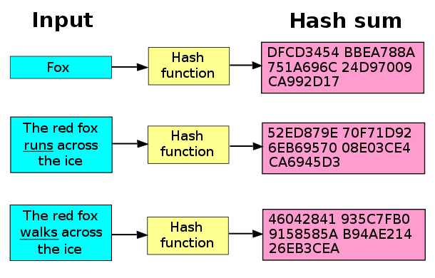
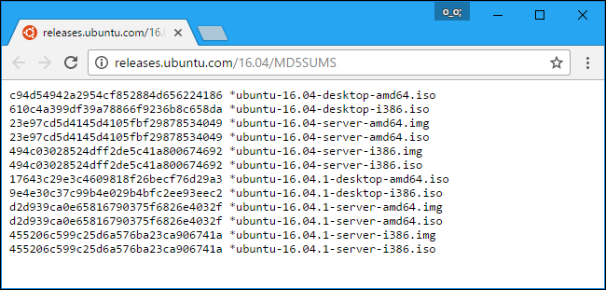
Hash function
(Nearly or pseudo) One-way function Application: - Instead store real data value, we can safety store the hash value in plain text file. Ex: hash(random + password),.. - Use for detect the modify intergrity of data . Ex: hash(install_file.msi),…

Slide 7
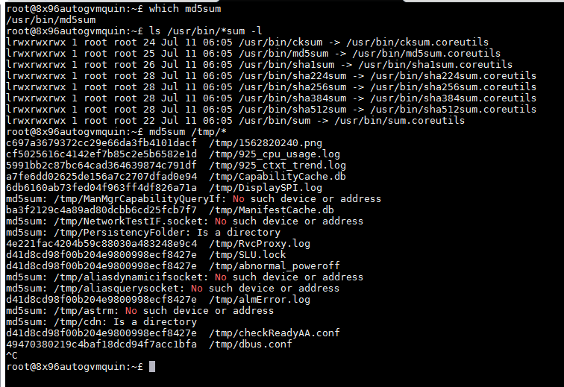
Hash function (cont)
Almost Linux/Unix system already have these hash program: md5sum sha1sum sha224sum sha256sum sha384sum sha512sum

Slide 8
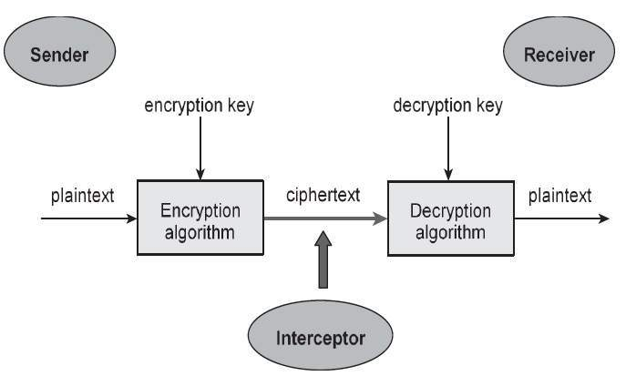
Types of Cryptography
Symmetric Key (“Secret Key”)
One key: secret (but possibly shared)
Asymmetric Key (“Public Key”)
Two keys: public & private
Hash Functions
No keys

Slide 9
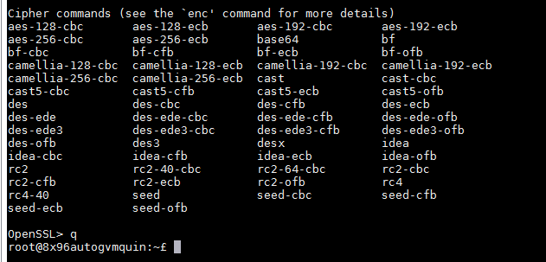
Symmetric Key (“Secret Key”)
Some common : AES, DES, IDEA, Camellia,…
Have good speed/performance, can be use for encrypt all hard disk data (TrueCrypt, LVM on luks,..)
Have good security level, it more secure many times when compare with asymmetric cryptosystem have same key length. Weakness: need a secure method to protect and transmit the secret key.

Slide 10
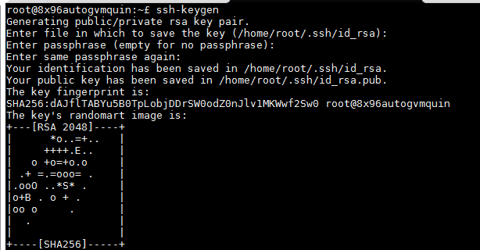
Asymmetric Key (“Public Key”)
The best wide-known is RSA. https://en.wikipedia.org/wiki/RSA_(cryptosystem)

Slide 11
Public Key Cryptosystem(cont)
Strength: Public the public key for every one know. Every one can encrypt data by public key, but only one have private key can decrypt data. Weakness: Very slow speed when compare with a secret key cryptosystem. More low security level when compare with a secret key cryptosystem have same key length. ➔ The way combination when work with a large data: 1) Use public key cryptosystem to encrypt only the key for secret key cryptosystem. 2) Use secret key cryptosystem for encrypt/decrypt data.

Slide 12
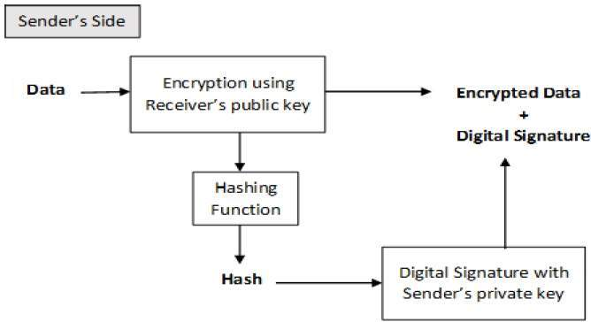
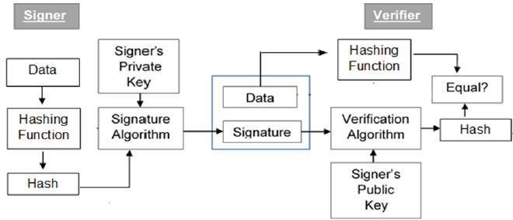
Digital signature
Always can use private key to sign on any data. Use your own (or an other organizer) Private key sign to an Publickey = Digital signature. Each public key cryptosystem, almost have an appropriate the algorithm for create it’s schema digital signature. (When sign to an public ket, it must have same algorithm, such as same RSA, DSA, ECC,…). A publickey have Digital signature => Certificate

Slide 13
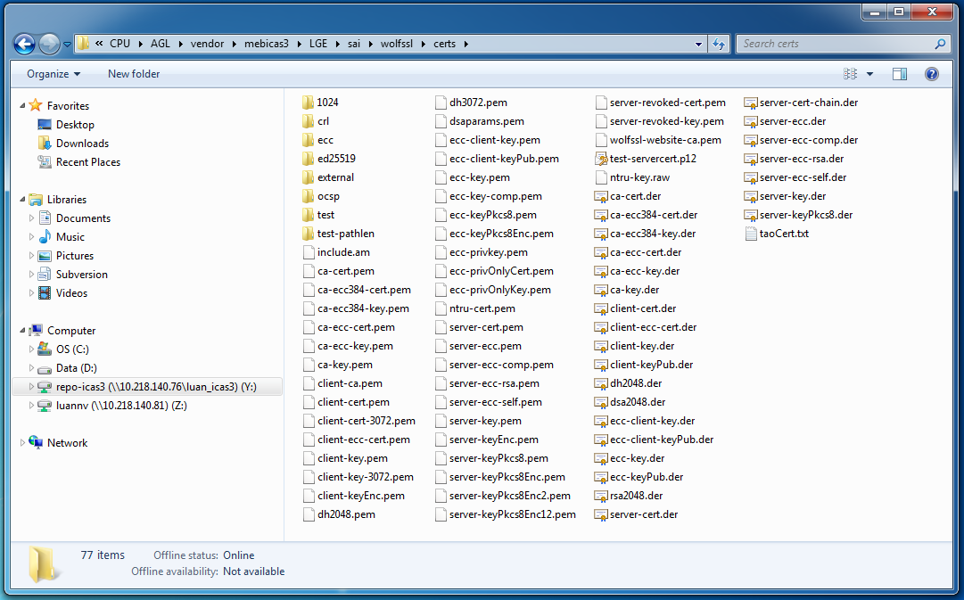
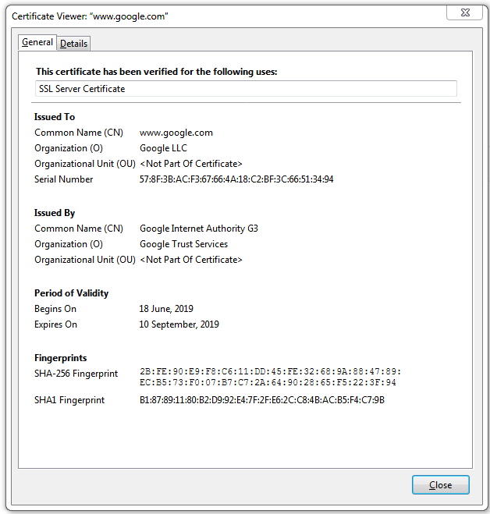
Certificate
A publickey have Digital signature => Certificate When you buy a certificate, it mean: you pay money for some reputation organizer (certificate authorities - CA), they will use their private key to sign on your own public key, to prove that public key is TRUE your own, not a public key of some one.

Slide 14
Certificate (cont)
The way for manage/store the public keys, sign for public key, certificate (issue/revocation certificate),…
https://en.wikipedia.org/wiki/X.509 https://tools.ietf.org/html/rfc5280
There are several commonly used filename extensions for X.509 certificates. Unfortunately, some of these extensions are also used for other data such as private keys.
.pem – (Privacy-enhanced Electronic Mail) Base64 encoded DER certificate, enclosed between "-----BEGIN CERTIFICATE-----" and "-----END CERTIFICATE-----"
.cer, .crt, .der – usually in binary DER form, but Base64-encoded certificates are common too (see .pem above)
.p7b, .p7c – PKCS#7 SignedData structure without data, just certificate(s) or CRL(s)
.p12 – PKCS#12, may contain certificate(s) (public) and private keys (password protected)
.pfx – PFX, predecessor of PKCS#12 (usually contains data in PKCS#12 format, e.g., with PFX files generated in IIS)

Slide 15
Secure Protocol
SSL(Secure Socket Layer)
TLS (Transport Layer Security)
SSH (Secure Shell)
SFTP (Secure File Transfer Protocol)
SCP (Secure Copy Protocol)
HTTPS (HTTP over SSL/TLS)

Slide 16
OpenSSL
Binary: /usr/bin/openssl
Framework: https://www.openssl.org/ https://en.wikipedia.org/wiki/OpenSSL https://github.com/openssl/openssl
The OpenSSL toolkit includes:
libssl (with platform specific naming): Provides the client and server-side implementations for SSLv3 and TLS.
libcrypto (with platform specific naming): Provides general cryptographic and X.509 support needed by SSL/TLS but not logically part of it.
openssl: A command line tool that can be used for: Creation of key parameters Creation of X.509 certificates, CSRs and CRLs Calculation of message digests Encryption and decryption SSL/TLS client and server tests Handling of S/MIME signed or encrypted
Algorithms
OpenSSL supports a number of different cryptographic algorithms:
Ciphers
AES, Blowfish, Camellia, Chacha20, Poly1305, SEED, CAST-128, DES, IDEA, RC2, RC4, RC5, Triple DES, GOST 28147-89,[16] SM4
Cryptographic hash functions
MD5, MD4, MD2, SHA-1, SHA-2, SHA-3, RIPEMD-160, MDC-2, GOST R 34.11-94,[16] BLAKE2, Whirlpool,[17] SM3
Public-key cryptography
RSA, DSA, Diffie–Hellman key exchange, Elliptic curve, X25519, Ed25519, X448, Ed448, GOST R 34.10-2001,[16] SM2
(Perfect forward secrecy is supported using elliptic curve Diffie–Hellman since version 1.0.[18])
FIPS 140-2 compliance

Slide 17
OpenSSL (cont)
Source and samples (ICAS3): Y:\CPU\AGL\vendor\mebicas3\LGE\sai\poco\Net\include\Poco\Net
Y:\CPU\AGL\vendor\mebicas3\LGE\sai\poco\NetSSL_OpenSSL\include\Poco\Net
Y:\CPU\AGL\vendor\mebicas3\LGE\sai\poco\Net\samples
Y:\CPU\AGL\vendor\mebicas3\LGE\sai\poco\NetSSL_OpenSSL\samples

Slide 18
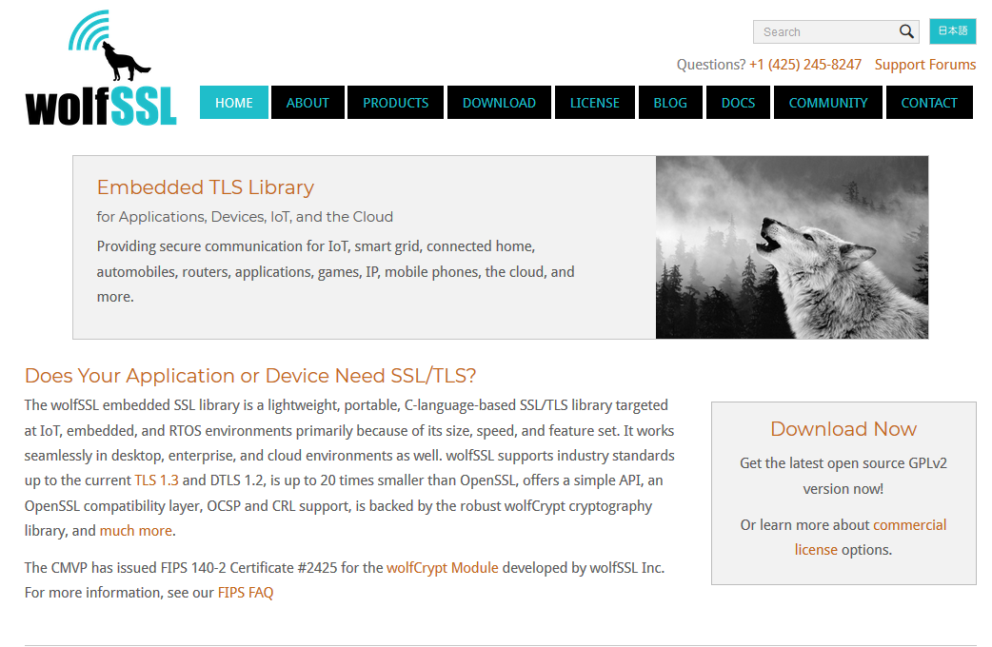
WolfSSL (for embedded system)
Embedded TLS Library for Applications, Devices, IoT, and the Cloud
Providing secure communication for IoT, smart grid, connected home, automobiles, routers, applications, games, IP, mobile phones, the cloud, and more.
https://en.wikipedia.org/wiki/WolfSSL https://www.wolfssl.com/

Slide 19
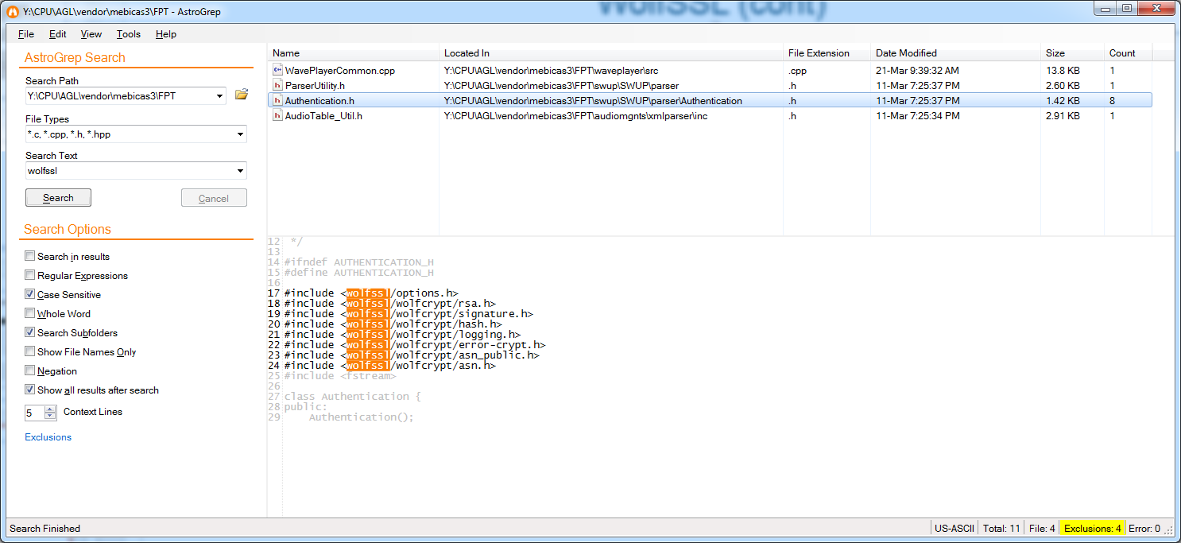
WolfSSL (cont)
Source: Y:\CPU\AGL\vendor\mebicas3\LGE\sai\wolfssl Y:\CPU\AGL\vendor\mebicas3\LGE\sai\wolfssl\wolfcrypt Y:\CPU\AGL\vendor\mebicas3\LGE\sai\wolfssl\wolfssl Y:\CPU\AGL\vendor\mebicas3\LGE\sai\wolfssl\wolfssl\wolfcrypt
Example: Y:\CPU\AGL\vendor\mebicas3\LGE\sai\wolfssl\examples Y:\CPU\AGL\vendor\mebicas3\LGE\sai\wolfssl\wolfcrypt\test\test.c

Slide 20
Conclusion
The use of any cryptosystem need some pre study/understand about that cryptosystem for use correct it. If you not sure, simply try like the sample.
Don’t try to write and use your own hash/cryptosystem for high sensitive data.
Always try add some bytes random data (as much as possible) with the real data you need protect.

Slide 21
Thanks for watching ☺

